Slide 1

SQL PROJECT ON IPL AUCTION
Motive:
Developing auction strategy for new IPL franchise by analyzing past IPL data to create a strong and balanced squad

Slide 2
Queries for tables created to fetch data
CREATE TABLE IPL_Matches
(id bigint,city varchar,date date,player_of_match varchar,venue varchar,neutral_venue int,team1 varchar,
team2 varchar,toss_winner varchar,toss_decision varchar,winner varchar,result varchar,result_margin int,
eliminator varchar,method varchar,umpire1 varchar,umpire2 varchar);
COPY IPL_Matches FROM 'C:\Program Files\PostgreSQL\15\data\Dataset\IPL Dataset\IPL_matches.csv' DELIMITER ',' CSV HEADER;
SET DATESTYLE TO "ISO, DMY";
CREATE TABLE IPL_Ball
(id bigint PRIMARY KEY,inning int,over int,ball int,batsman varchar,non_striker varchar,bowler varchar,
batsman_runs int,extra_runs int,total_runs int,is_wicket int,dismissal_kind varchar,player_dismissed varchar,
fielder varchar,extras_type varchar,batting_team varchar,bowling_team varchar);
COPY IPL_Ball FROM 'C:\Program Files\PostgreSQL\15\data\Dataset\IPL Dataset\IPL_Ball.csv' DELIMITER ',' CSV HEADER;

Slide 3
Bidding on batters

Slide 4
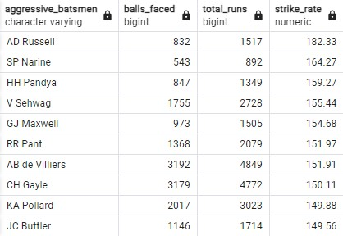
Aggressive Batsmen
Query:
select batsman as aggressive_batsmen,
count(ball) as balls_faced,
sum(batsman_runs) as total_runs,
round(sum(batsman_runs)*1.0/count(ball)*100,2) as strike_rate
from ipl_ball where not extras_type='wides'
group by batsman having count(ball)>=500
order by strike_rate desc limit 10;

Slide 5
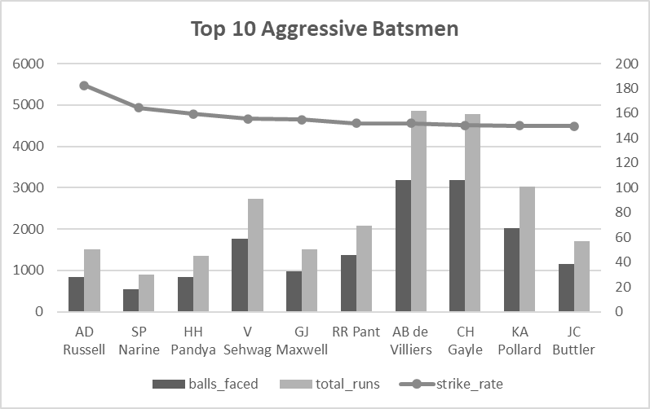
chart

Slide 6
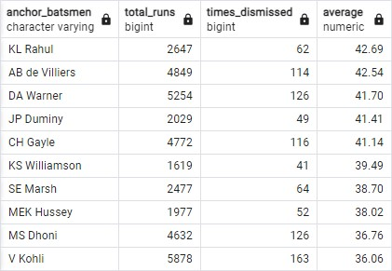
Anchor Batsmen
Query:
select batsman as anchor_batsmen,
sum(batsman_runs) as total_runs,
sum(is_wicket) as times_dismissed,
round(sum(batsman_runs)*1.0/sum(is_wicket),2) as average
from ipl_ball group by batsman
having (count(distinct id))/14>2 and sum(is_wicket)>0
order by average desc limit 10;

Slide 7
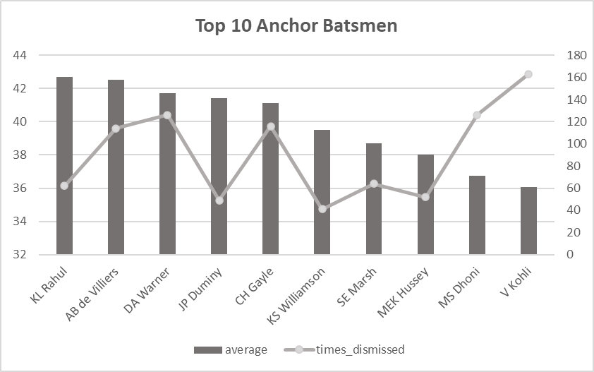
chart

Slide 8
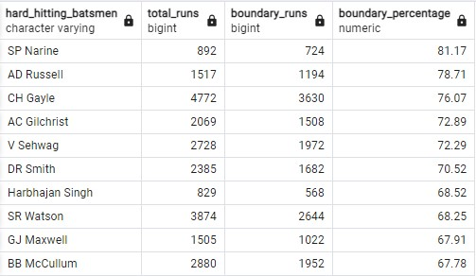
Hard-hitting batsmen
Query:
SELECT batsman as hard_hitting_batsmen,
SUM(Batsman_Runs) AS Total_Runs,
SUM(CASE
WHEN Batsman_Runs = 4 OR Batsman_Runs = 6 THEN Batsman_Runs
ELSE 0
END) AS Boundary_Runs,
ROUND((SUM(CASE
WHEN Batsman_Runs = 4 OR Batsman_Runs = 6 THEN Batsman_Runs
ELSE 0 END)*1.0/SUM(Batsman_Runs))*100,2)
AS Boundary_Percentage
FROM IPL_Ball group by batsman
having (count(distinct id)/14)>2
order by boundary_percentage desc
limit 10;

Slide 9
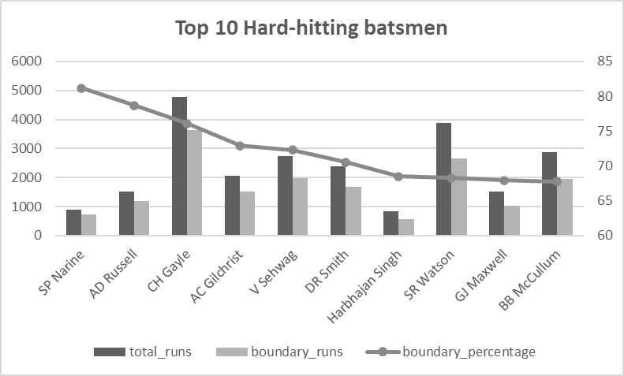
chart

Slide 10
Bidding on bowlers

Slide 11
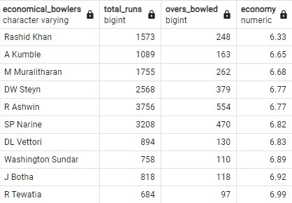
Economical bowlers
Query:
select bowler as economical_bowlers,
sum(total_runs) as total_runs,
count(bowler)/6 as overs_bowled,
round(sum(total_runs)/(count(bowler)/6.0),2) as economy
from ipl_ball group by bowler
having count(ball)>=500 order by economy asc
limit 10;

Slide 12
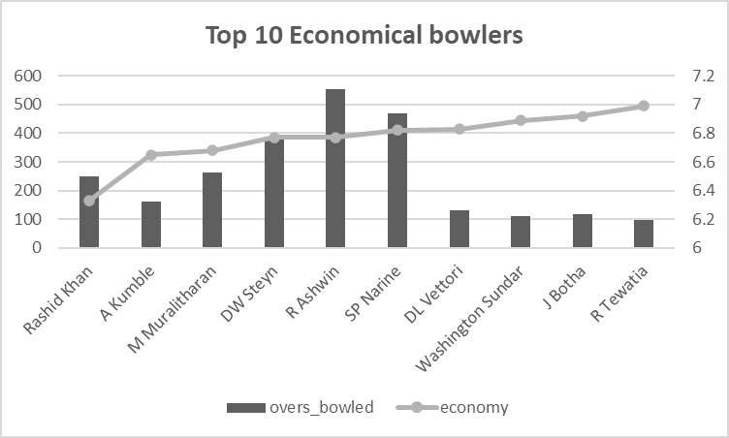
chart

Slide 13
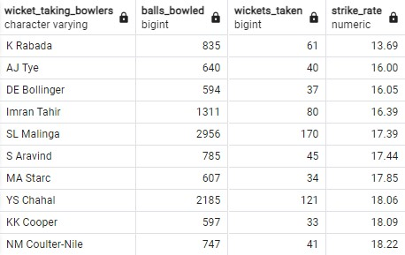
Wicket-taking bowlers
Query:
select bowler as wicket_taking_bowlers,
count(ball) as balls_bowled,
sum(is_wicket) as wickets_taken,
round(count(ball)*1.0/sum(is_wicket),2) as strike_rate
from ipl_ball
where dismissal_kind not in ('run out','retired hurt','obstructing the field')
group by bowler having count(ball)>=500
order by strike_rate asc limit 10;

Slide 14
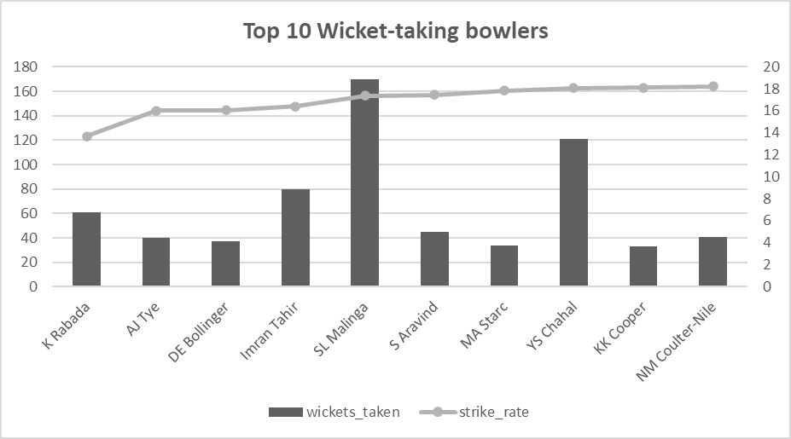
chart

Slide 15
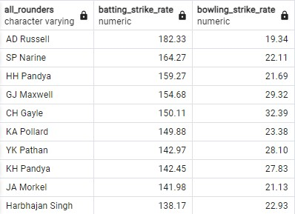
All rounders
Query:
select a.batsman as all_rounders,
round(sum(a.batsman_runs)*1.0/count(a.ball)*100,2) as batting_strike_rate,
b.bowling_strike_rate from ipl_ball as a
inner join (select bowler,
round(count(ball)*1.0/sum(is_wicket),2) as bowling_strike_rate
from ipl_ball
where dismissal_kind not in ('run out','retired hurt','obstructing the field')
group by bowler having count(ball)>=300
order by bowling_strike_rate asc) as b
on a.batsman=b.bowler
where not extras_type='wides'
group by batsman,bowling_strike_rate
having count(a.ball)>=500
order by batting_strike_rate desc,bowling_strike_rate desc
limit 10;

Slide 16
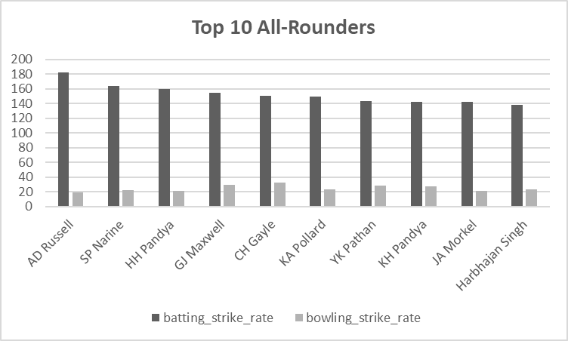
chart

Slide 17
Wicket keepers
Criteria for choosing the best wicketkeepers:
The fielders with the most dismissals for dismissal type- ‘Stumped’
Explanation:
The dismissals are calculated by wickets taken and the respective fielder when the batsman is dismissed is a wicketkeeper when the dismissal type is ‘stumped’.
When dismissal types chosen are ‘run out, caught, stumped’, some records are marked ‘NA’ in the result set and possibility that ‘run out’ dismissal happened because of the wicketkeeper is low.
When dismissal types chosen are ‘caught, stumped’, some of the fielders listed in the result set are not wicketkeepers.
But when dismissal type chosen is only ‘stumped’, all the fielders listed in the result set are wicketkeepers with the top ones being MS Dhoni, RV Uthappa, KD Karthik etc.

Slide 18
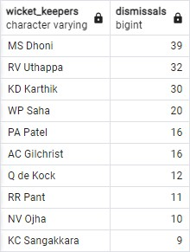
Query:
select fielder as wicket_keepers,sum(is_wicket) as dismissals from ipl_ball
where dismissal_kind in ('stumped')
group by fielder order by dismissals desc limit 10;

Slide 19
Additional questions

Slide 20
Queries for tables created to fetch data
CREATE TABLE Deliveries
(id bigint,inning int,over int,ball int,batsman varchar,non_striker varchar,
bowler varchar,batsman_runs int,extra_runs int,total_runs int,
is_wicket int,dismissal_kind varchar,player_dismissed varchar,
fielder varchar,extras_type varchar,batting_team varchar,
bowling_team varchar);
COPY Deliveries FROM 'C:\Program Files\PostgreSQL\15\data\Dataset\IPL Dataset\IPL_Ball.csv’
DELIMITER ',' CSV HEADER;
CREATE TABLE matches AS SELECT * FROM ipl_matches;

Slide 21

Q1. Get the count of cities that have hosted an IPL match
Query:
select count(distinct city) as ipl_city from ipl_matches;

Slide 22
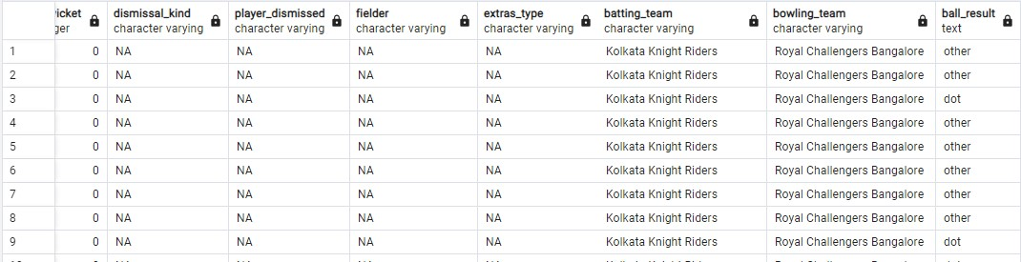
Q2. Create table deliveries_v02 with all the columns of the table ‘deliveries’ and an additional column ball_result containing values boundary, dot or other depending on the total_run
Query:
CREATE TABLE deliveries_v02 AS (SELECT *, CASE WHEN total_runs>=4 THEN 'boundary'
WHEN total_runs=0 THEN 'dot'
ELSE 'other'
END AS ball_result
FROM Deliveries);

Slide 23

Q3. Write a query to fetch the total number of boundaries and dot balls from the deliveries_v02 table
Query:
select ball_result,count(ball_result) as no_of_balls
from deliveries_v02 where ball_result in ('boundary','dot')
group by ball_result;

Slide 24
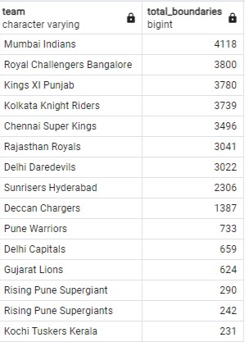
Q4. Write a query to fetch the total number of boundaries scored by each team from the deliveries_v02 table and order it in descending order of the number of boundaries scored.
Query:
select batting_team as team,
count(ball_result) as total_boundaries
from deliveries_v02 where ball_result='boundary'
group by batting_team
order by total_boundaries desc;

Slide 25
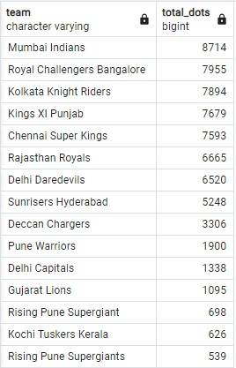
Q5. Write a query to fetch the total number of dot balls bowled by each team and order it in descending order of the total number of dot balls bowled.
Query:
select bowling_team as team,
count(ball_result) as total_dots
from deliveries_v02 where ball_result='dot'
group by bowling_team
order by total_dots desc;

Slide 26
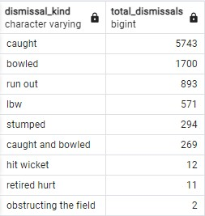
Q6. Write a query to fetch the total number of dismissals by dismissal kinds where dismissal kind is not NA
Query:
select dismissal_kind,count(dismissal_kind) as total_dismissals
from deliveries_v02
where not dismissal_kind='NA'
group by dismissal_kind
order by total_dismissals desc;

Slide 27
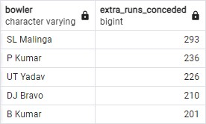
Q7. Write a query to get the top 5 bowlers who conceded maximum extra runs from the deliveries table
Query:
select bowler,sum(extra_runs) as extra_runs_conceded
from deliveries where not extra_runs=0
group by bowler order by extra_runs_conceded desc limit 5;

Slide 28
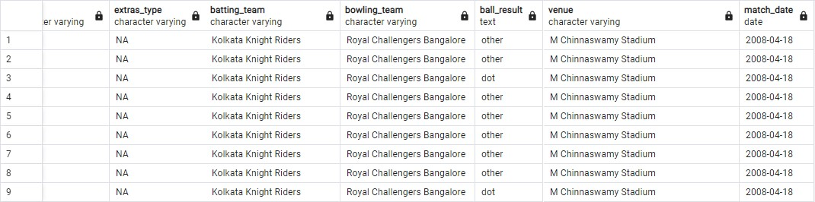
Q8. Write a query to create a table named deliveries_v03 with all the columns of deliveries_v02 table and two additional column (named venue and match_date) of venue and date from table matches
Query:
CREATE TABLE deliveries_v03 AS (select a.*,b.venue as venue,b.date as match_date
from deliveries_v02 as a
left join matches as b
on a.id=b.id);
select * from deliveries_v03;

Slide 29
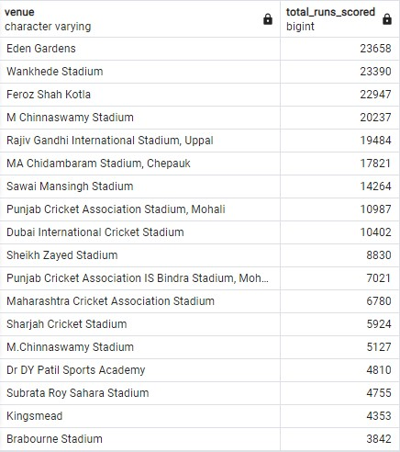
Q9. Write a query to fetch the total runs scored for each venue and order it in the descending order of total runs scored.
Query:
select venue,sum(total_runs) as total_runs_scored
from deliveries_v03
group by venue
order by total_runs_scored desc;
(Top 18 venues
wrt. total_runs_scored)

Slide 30
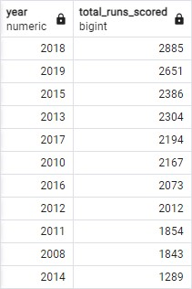
Q10. Write a query to fetch the year-wise total runs scored at Eden gardens and order it in the descending order of total runs scored.
Query:
select extract(year from match_date) as year,
sum(total_runs) as total_runs_scored from deliveries_v03
where venue='Eden Gardens'
group by year order by total_runs_scored desc;

Slide 31
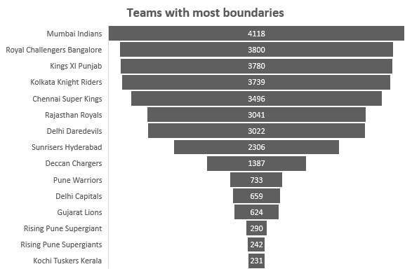
charts

